Slide 1

Customer Shopping Behavior Analysis
Uncovering insights from 3,900 purchases to guide strategic business decisions through data-driven analysis of spending patterns, customer segments, and product preferences.

Slide 2
DATASET OVERVIEW
Understanding Our Data Foundation
3,900
18
50
Total Purchases
Data Points
Locations
Transactions analyzed across all categories
Features per customer transaction
Geographic coverage across regions
Key Features Tracked
Customer demographics: Age, Gender, Location, Subscription Status
Purchase details: Item, Category, Amount, Season, Size, Color
Shopping behavior: Discounts, Promo Codes, Previous Purchases, Review Ratings

Slide 3

PYTHON ANALYSIS
Data Preparation & Cleaning
01
02
Data Loading & Exploration
Missing Data Handling
Imported dataset using pandas and examined structure with info() and describe() methods
Imputed 37 missing Review Rating values using median rating per product category
03
04
Feature Engineering
Database Integration
Created age_group bins and purchase_frequency_days columns for deeper analysis
Connected to PostgreSQL and loaded cleaned data for SQL business analysis

Slide 4

SQL ANALYSIS
Key Business Questions Answered
Structured PostgreSQL analysis revealed critical insights across revenue, customer behavior, and product performance to drive strategic decisions.

Slide 5
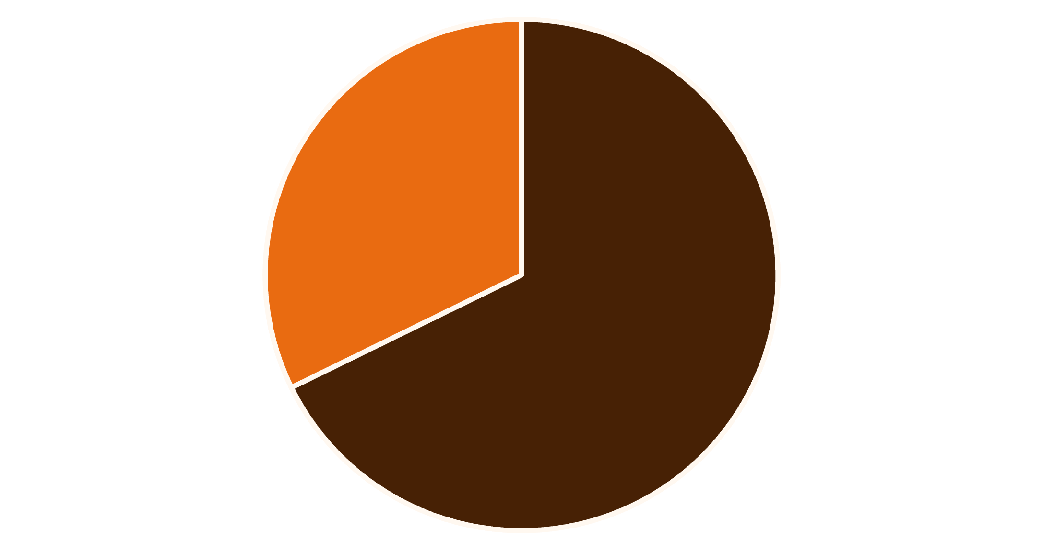
Revenue & Customer Insights
Gender Revenue Distribution
Male customers generated $157,890 in total revenue (68%), significantly outpacing female customers at $75,191 (32%).
Smart Discount Users
Identified 839 customers who used discounts but still spent above average ($59.76), indicating price-conscious yet high-value shoppers.
Male
Female

Slide 6
Product Performance Analysis
Top 5 Products by Rating
86%
84%
82%
Gloves
Sandals
Boots
3.86 average rating
3.84 average rating
3.82 average rating
80%
78%
Hat
Skirt
3.80 average rating
3.78 average rating
Discount-Dependent Products
Hat leads with 50% of purchases using discounts, followed by Sneakers (49.66%), Coat (49.07%), Sweater (48.17%), and Pants (47.37%).

Slide 7



Customer Segmentation Breakdown
Loyal Customers
Returning Customers
New Customers
3,116 customers (80%) with consistent purchase history
701 customers (18%) showing repeat interest
83 customers (2%) just starting their journey
Analysis reveals 958 of 3,476 repeat buyers (>5 purchases) have subscriptions, indicating subscription potential among loyal customers.

Slide 8

POWER BI DASHBOARD
Interactive Visual Analytics
Dashboard Highlights
Subscription Status
Category Leaders
Age Group Insights
27% subscribed, 73% non-subscribers
Clothing dominates with $100K revenue, 1,800 sales
Young Adults lead with $45K revenue

Slide 9
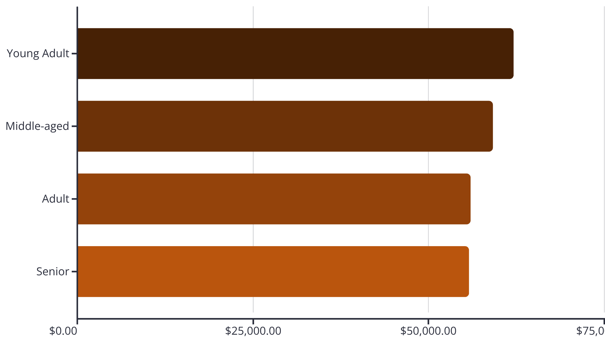
Revenue Distribution Analysis
Key Findings
Young Adults contribute highest revenue at $62,143, with relatively balanced distribution across all age groups.
Shipping Preferences
Express shipping users spend $60.48 on average versus $58.46 for Standard, indicating willingness to pay premium for faster delivery.

Slide 10

STRATEGIC RECOMMENDATIONS
Actionable Business Strategies
Boost Subscriptions
Promote exclusive benefits to convert the 73% non-subscribers, especially among repeat buyers
Loyalty Programs
Reward repeat buyers to accelerate movement into the Loyal segment (currently 80%)
Review Discount Policy
Balance sales boosts with margin control for discount-dependent products like Hats and Sneakers
Targeted Marketing
Focus on high-revenue Young Adults and express-shipping users willing to pay premium

